Slide 1
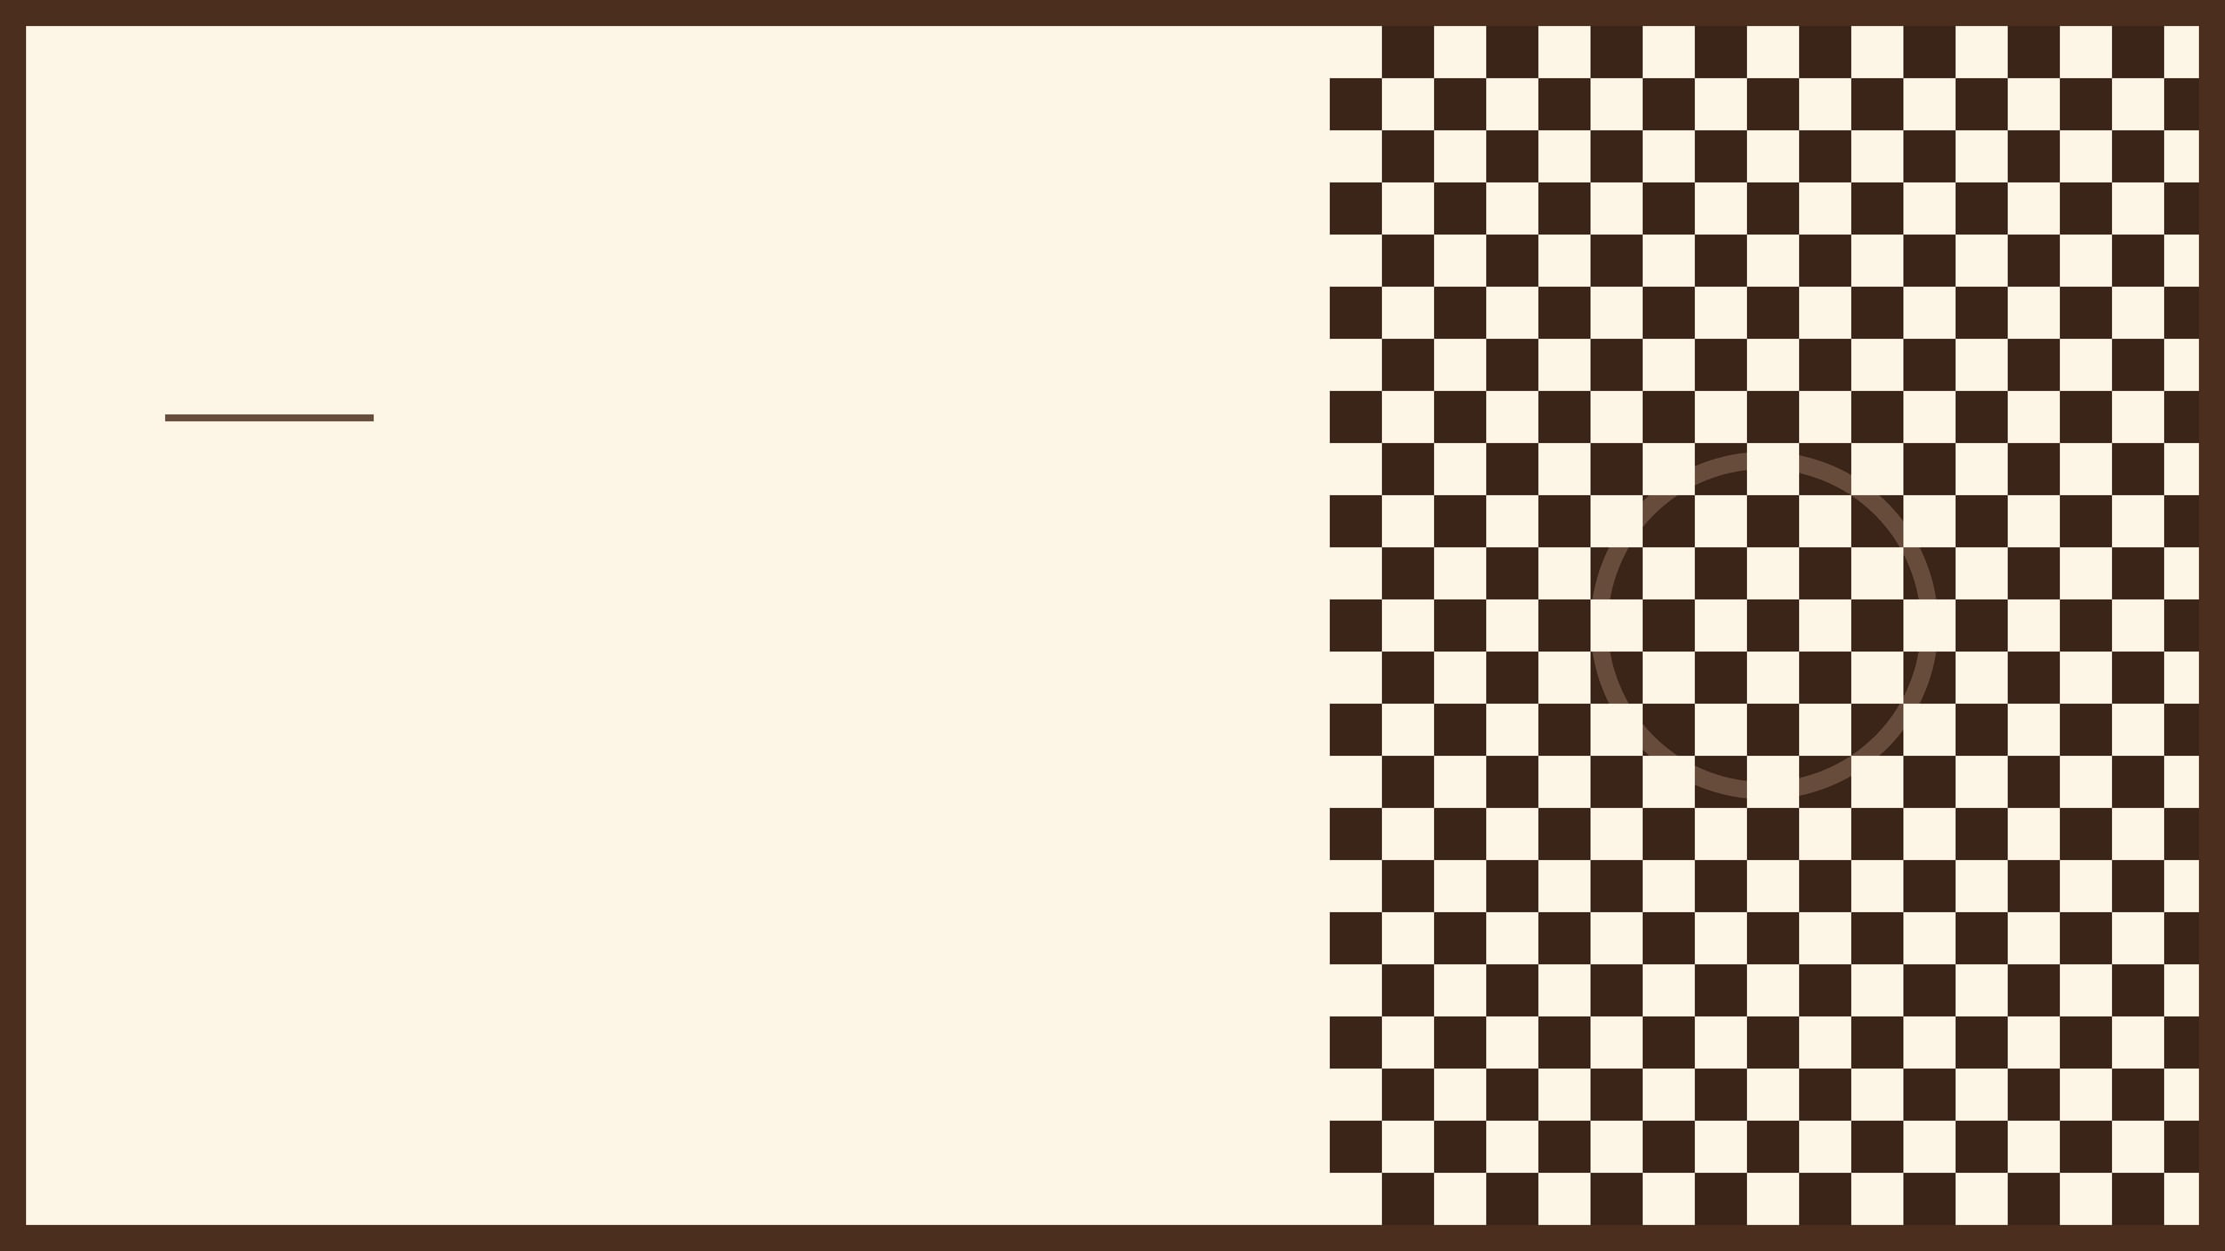
HISTORY, ORIGINS, AND STRATEGY
DRAUGHTS
The Game of Draughts
A Comprehensive Guide to the World's Oldest Strategy Game

Slide 2

The Ancestor
Archaeological Evidence
1400 BC
ALQUERQUE (QUIRKAT)
The roots of Draughts lie in Alquerque, an ancient board game played on a 5x5 grid. Unlike the modern game, pieces were moved along lines rather than squares.
The earliest physical evidence of Draughts-like games was found in the Kurna Temple in Egypt. Archaeological digs revealed boards carved directly into roofing slabs, dating back over 3,400 years.
This venerable game was brought to Europe by the Moors, serving as the foundational logic for the Draughts we play today.
This discovery proves that the fundamental concepts of strategic piece movement and capturing are among the oldest intellectual pursuits in human history.
"Alquerque boards have been found in digs dating as far back as the Egyptian era, marking the start of a millennia-long evolution."

Slide 3

The 1100 AD Innovation
Etymology & Names
DRAUGHTS VS. CHECKERS
THE 64-SQUARE LEAP
The name "Draughts" is derived from the Old English verb "to draw" or "to move," referencing the physical act of pulling pieces across the board.
Around 1100 AD in France, the game underwent a transformative adaptation. It was moved from the lines of the Alquerque board to the squares of a standard 8x8 chessboard.
The American term "Checkers" refers directly to the checkered pattern of the 8x8 board on which the game is played.
This version was initially called Fierges or Ferses, marking the birth of the game's modern visual identity.
8x8
The standardized grid that defined the game's tactical depth for the next millennium.

Slide 4
Foundational Work
Historical Significance
Valencia, Spain
1547 PUBLICATION
Published in Valencia, Spain, "El Ingenio o Juego de Marro, de Punta o Damas" by Antonio de Torquemada is the earliest known modern book on Draughts.
Torquemada's treatise established Draughts as a game of profound strategic depth. It provided the first written record of tactical analysis, bridging the gap between ancient Alquerque traditions and modern competitive play.
This work marked the transition of the game from a folk tradition to a subject of formal intellectual study.
By documenting the game's logic, Torquemada ensured its survival and growth as a respected intellectual pursuit across Europe during the Renaissance.
"The earliest modern book on checkers, known in England as draughts, was written by Antonio Torquemada and published in Valencia, Spain, in 1547."

Slide 5

Standardization
Literary Legacy
Samuel Johnson
THE 1756 LAWS
Mathematician William Payne published "An Introduction to the Game of Draughts" in 1756. This work provided the first clear and widely accepted set of laws for the English game.
The book's dedication and preface were famously written by the renowned lexicographer Samuel Johnson. This collaboration lent significant cultural and intellectual weight to the game.
Johnson's involvement signaled that Draughts was a game worthy of the highest scholarly attention, cementing its place in the intellectual canon of the 18th century.
Payne's mathematical approach helped formalize the game's logic, moving it from a casual pastime to a disciplined strategy game.
"Payne’s work remains the bedrock of modern English Draughts, standardizing movement, capture, and the formal conduct of play."

Slide 6

Fundamentals: How to Play
01
02
03
MOVEMENT
CAPTURING
CROWNING
The game is played exclusively on the 32 dark squares of an 8x8 board. Standard pieces (men) move diagonally forward one square at a time to an empty adjacent square.
Capturing is mandatory. If an opponent's piece is adjacent and the square behind it is empty, you must jump over it and remove it from the board.
When a piece reaches the furthest row (the Crown Head), it is promoted to a King. This is typically indicated by stacking a second piece on top.
If the landing square allows for another jump, the player must continue the sequence in a single turn.
Kings gain the unique ability to move and capture both forward and backward, significantly increasing their tactical value.
Players alternate turns, moving one piece per turn unless a capture is made.

Slide 7

Strategic Glossary of Terms
KING
HUFFING
DOUBLE CORNER
A piece that has reached the opposite side of the board and is promoted, gaining the ability to move and capture both forward and backward.
An obsolete rule where a player could remove an opponent's piece if they failed to make a mandatory capture.
The two dark squares at the right-hand side of each player. These are critical tactical positions in endgame scenarios.
CROWN HEAD
SINGLE CORNER
MAN
The row of squares furthest from a player. Reaching this row is the requirement for crowning a piece into a King.
The dark square at the left-hand side of each player's board, often used as a defensive anchor.
A standard piece that has not yet been promoted. It can only move and capture in a forward diagonal direction.

Slide 8

The Penalty
Modern Transition
FROM PENALTY TO MANDATE
WHAT IS "HUFFING"?
In contemporary competitive play, the huffing rule is considered obsolete. It has been replaced by the "mandatory capture" requirement, where any move that misses a jump must be undone and the capture taken.
Historically, if a player failed to make a mandatory capture, the opponent had the right to "huff" (remove) the piece that should have jumped before making their own move.
This shift ensures that games are decided by strategic depth rather than simple oversight, though huffing remains a fascinating relic of the game's social history.
The term comes from the practice of blowing on the piece before removing it from the board, adding a layer of psychological pressure.
"Huffing was a test of vigilance; modern rules are a test of calculation."

Slide 9

FAQ: Common Questions Answered
Are Checkers and Draughts different?
Who standardized the rules?
No, they are the same game. "Draughts" is the traditional British name, while "Checkers" is the term used in North America. Both refer to the same 8x8 strategy game.
The rules of English Draughts were standardized by William Payne in 1756. His book provided the first formal set of laws that govern modern play.
Is jumping always mandatory?
What was the first book written?
Yes. In standard English Draughts, if a move allows for a capture, the player must take it. This rule is fundamental to the game's tactical depth.
The earliest modern treatise was written by Antonio de Torquemada in 1547. It established the game as a subject of serious intellectual study.

Slide 10

Conclusion: A Legacy of Strategy
01
02
03
ENDURANCE
ACCESSIBILITY
RESOURCES
Draughts has survived for millennia, evolving from ancient Alquerque to a standardized global pursuit of tactical excellence.
The game remains a masterclass in simplicity, offering profound strategic depth accessible to players of all ages and backgrounds.
For a detailed glossary, FAQ, and historical timeline, refer to the accompanying Draughts Comprehensive Report.
The Game of Draughts | Historical Review 2026

